Slide 1

Hope for the Downcast Soul
Psalm 42

Slide 2
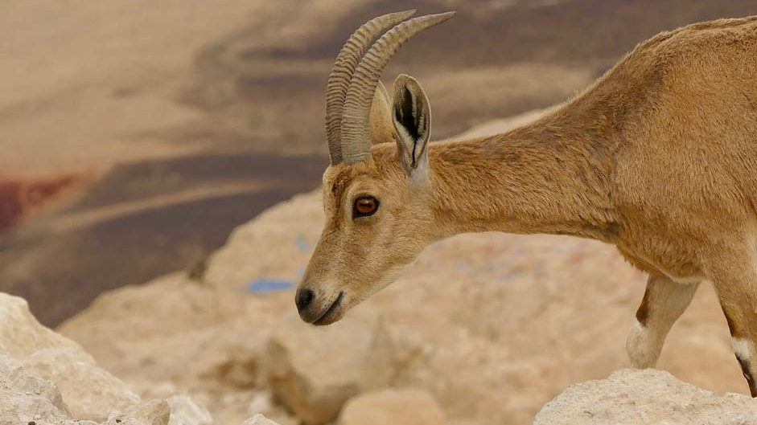

Slide 3
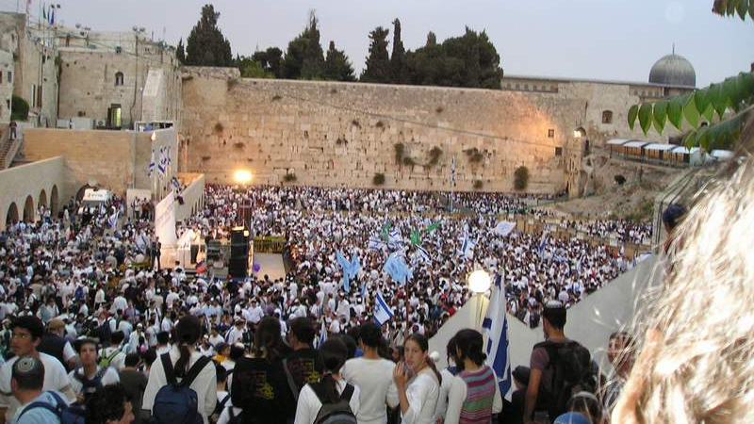

Slide 4
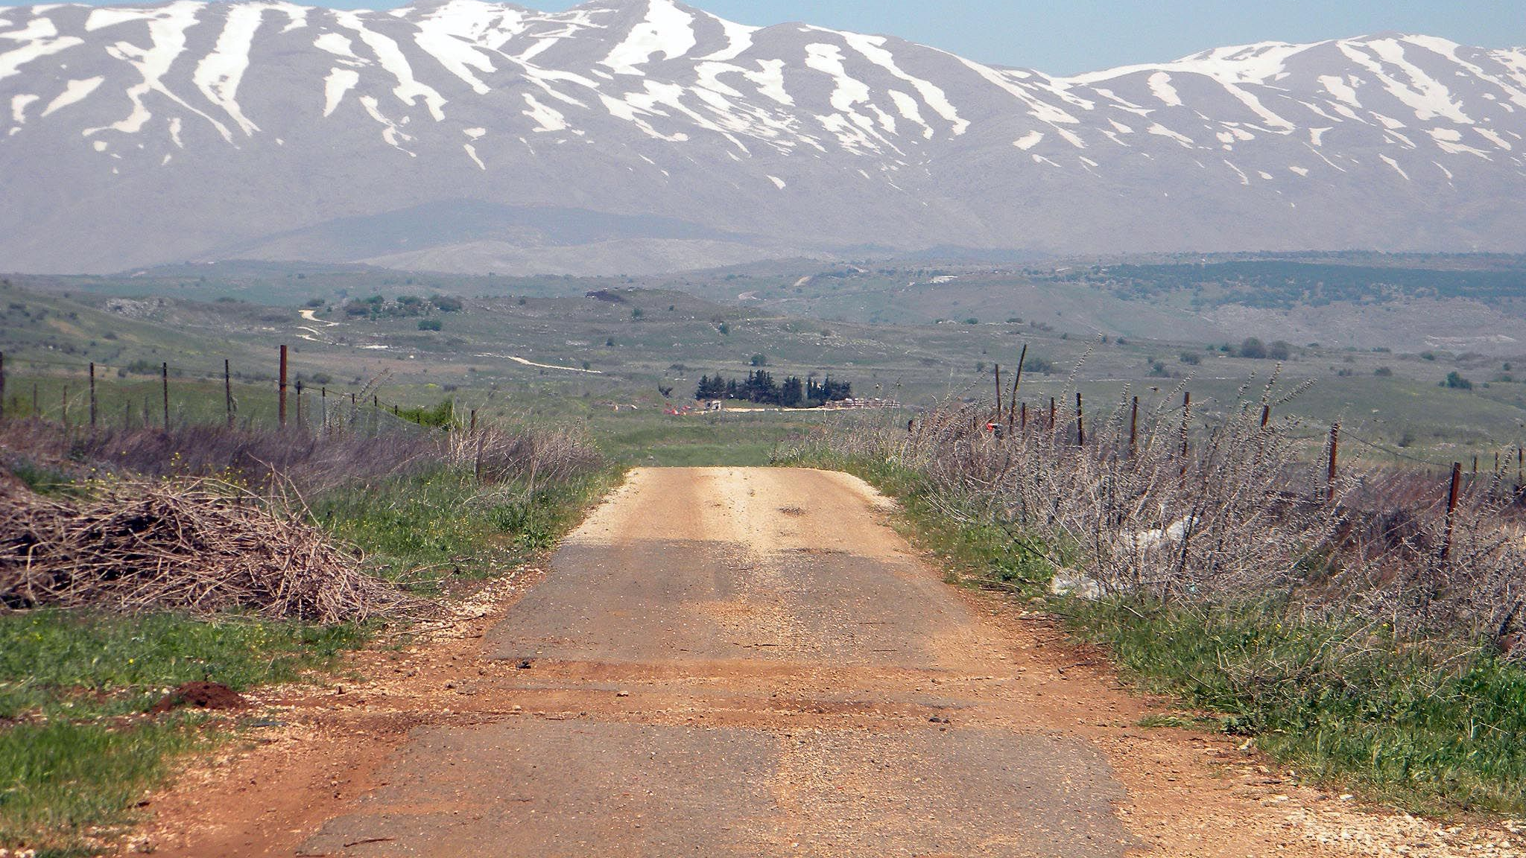

Slide 5
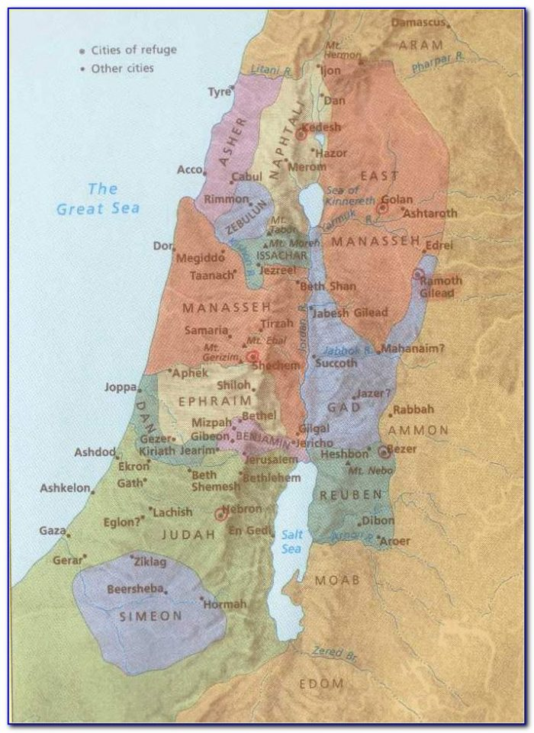

Slide 6


Slide 7

Nature of the Downcast Soul
Inevitable
Causes
  Sin
  Life not fair

Slide 8
Remedy for the Downcast Soul
Speak out feelings
01
Hope in God
02
Encourage yourself
03

